Slide 1

Hashing
Notes:
https://www.digicert.com/ssl-cryptography.htm
https://www.wolframalpha.com/input/?i=79%5E(-1)+mod+3220&wal=header
Openssl
https://www.kinamo.be/en/support/faq/useful-openssl-commands
Math basics
https://www.mathsisfun.com/definitions/relatively-prime.html

Slide 2
Outline
Cryptographic Hash Function
Message Authentication Code (MAC)
Digital Signature

Slide 3
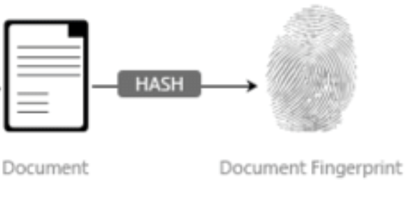
Cryptographic Hash Function

Slide 4
Properties of a Cryptographic Hash Function
h = H(m). Hash(Variable size message m) to produce a fixed size hash value (sometimes called a message digest)
Efficient computation
Pseudorandom (small change of m yields a big change of h)
Cryptographic hash function has 2 properties:
Pre-image Resistant (the one-way property): Infeasible to determine m from H(m)
Collision Resistant (the collision-free property): Infeasible to find any two messages m₁ and m₂ such that m₁ ≠ m₂ and H(m₁) = H(m₂)
Notes:
Because we are using hash functions for data integrity, collisions are clearly undesirable
Alternate names are fingerprint or digest
(a) a data object that maps to a pre-specified hash result (the one-way property)
(b) two data objects that map to the same hash result (the collision-free property)
2nd Pre-image Resistant = Weak Collision Resistant. Given m₁ , infeasible to find m₂ with equal hash (i.e., such h(m₁)=h(m₂)
: take variable-length message, compute a fixed length hash
Used outside of security as well
Not all hash functions can be used for security
We are concerned with cryptographic hash functions
Pre-image resistance
Infeasible to determine M from H(M)
Second pre-image resistance
Given M₁, infeasible to find M₂ such that H(M₁) = H(M₂)
Collision resistance
Can’t find any M₁, M₂ such that H(M₁) = H(M₂)
Breaking Pre-Image Resistance
Given a hash, find a message with the same hash
Bruteforce approach: Pick a message, hash it, compare to the hash you have
How long will this take?
Best case: First guess is correct! (1)
Worst case: You find all others first (2¹²⁸ - 1 )
Average case: You find it halfway through (~2¹²⁸/2 = 2¹²⁷)

Slide 5
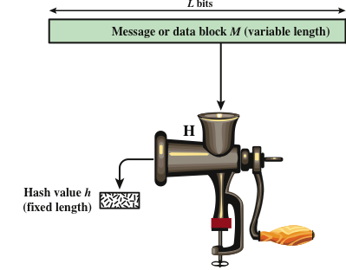

Analogy

Slide 6
Sample in Python
Data (??-bits)
SHA256
Hash (256 bits)
import hashlib md = hashlib.sha256(b"The quick brown fox jumps over the lazy dog").hexdigest() print (md)
d7a8fbb307d7809469ca9abcb0082e4f8d5651e46d3cdb762d02d0bf37c9e592

Slide 7
Examples of Real Hash Functions
MD5 (Message Digest 5)
Produces a 128-bit hash
Collisions can be found. An attacker can use them to substitute an authorized message with an unauthorized one.
SHA1 (Secure Hash Algorithm 1)
160-bit hash
Collisions can be found
SHA2
Actually 4 different hash functions: SHA-224, SHA-256, SHA-384, SHA-512
Minor attacks, but still good
SHA3
New NIST standard
No known attacks
Notes:
No one has demonstrated a technique for producing collisions in a practical amount of time
NIST announced in 2007 a competition for the SHA-3 next generation NIST hash function
Winning design was announced by NIST in October 2012
An attacker who can find any of the above computations can use them to substitute an authorized message with an unauthorized one.
MD5 - Collisions can be found in ~2^21 hashes.
SHA 1 Collisions can be found in 2^61 hashes
MD4 = Message Digest 4 [RFC 1320] - 32b operations
❑
MD5 = Message Digest 5 [RFC 1321] - 32b operations
❑
SHA = Secure hash algorithm [NIST]
❑
SHA-1 = Updated SHA
❑
SHA-2 = SHA-224, SHA-256, SHA-384, SHA-512 SHA-512 uses 64-bit operations

Slide 8
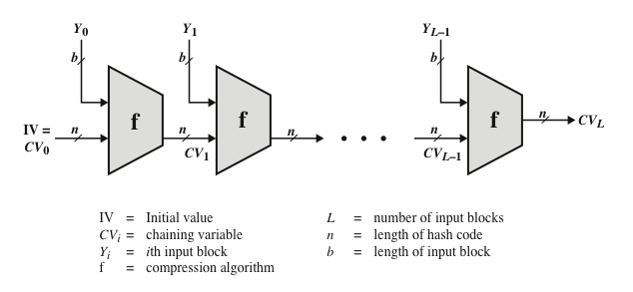
General Structure of Secure Hash Function
Break input message into equal-sized blocks
Apply a compression function f iteratively to blocks Y_{i}
Use output of previous stage CV_{i} as input to the next
Notes:
As with encryption algorithms, cryptanalytic attacks on hash functions seek to exploit some property of the algorithm to perform some attack other than an exhaustive search. In recent years, have much effort, and some successes, in developing cryptanalytic attacks on hash functions. Must consider the overall structure of a typical secure hash function, referred to as an iterated hash function, as indicated in Stallings Figure 11.7. This was proposed by Merkle and is the structure of most hash functions in use today. The hash function takes an input message and partitions it into L fixed-sized blocks of b bits each. If necessary, the final block is padded to b bits. The final block also includes the value of the total length of the input to the hash function. The inclusion of the length makes the job of the opponent more difficult. The hash algorithm involves repeated use of a compression function, f, that takes two inputs (an n-bit input from the previous step, called the chaining variable, and a b-bit block) and produces an n-bit output. At the start of hashing, the chaining variable has an initial value that is specified as part of the algorithm. The final value of the chaining variable is the hash value. Often, b > n; hence the term compression. The motivation for this iterative structure stems from the observation by Merkle and Damgard that if the compression function is collision resistant, then so is the resultant iterated hash function. Therefore, the structure can be used to produce a secure hash function to operate on a message of any length. Cryptanalysis of hash functions focuses on the internal structure of f and is based on attempts to find efficient techniques for producing collisions for a single execution of f. Once that is done, the attack must take into account the fixed value of IV. The attack on f depends on exploiting its internal structure. The attacks that have been mounted on hash functions are rather complex and beyond our scope here.
Start with initialization vector IV initialized with 0
Select a cryptographic hash function f(m, d)

Slide 9
Applications of Hash Functions
Message Authentication: Integrity + Source Authentication
Integrity to ensure that the message has not been modified in transit
Source Authentication: the receiver is assured of the origin of the message
Encrypt hash using a shared secret key
Digital Signatures: Encrypt hash with private key to ensure Integrity + Source Authentication + Non-repudiation
Password storage: Stored hashed password with a salt.
When a user enters a password, the hash of that password is compared to the stored hash value for verification
Hackers can not get password from storage.
More!
Detect errors in file transfers.
Pseudorandom number generation: Hash an IV, Hash the hash, …, repeat
Notes:
Bittorrent does this
Can encrypt Message, hash, or both for confidentiality
Message Authentication Code (MAC)
Password storage
so that no one else can modify m and the hash

Slide 10
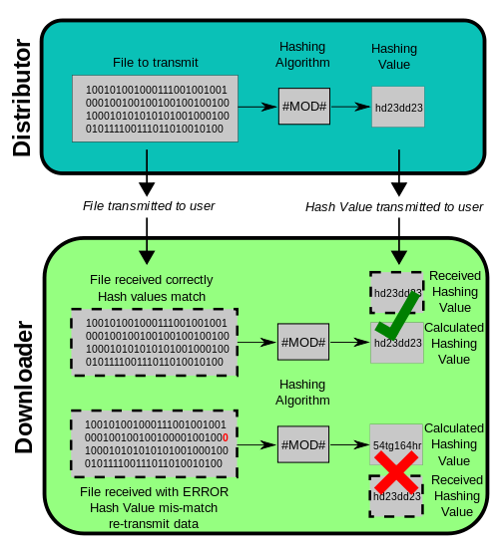
Application: File Transmission
https://en.wikipedia.org/wiki/MD5
Notes:
openssl sha256 .\WebStorm-2018.2.4.exe

Slide 11

Application: Password Storage
When designing an application that stores passwords, don’t store them in plaintext
If someone steals your password file, then they have all the user passwords!
Store salted hashed passwords instead
A salt is random data (similar to nonce) that is concatenated with the password then hashed.
The primary function of salts is to defend against dictionary attacks.
=> Using a different slat produces a different hash

Slide 12
Breaking Collision Resistance
Things get more complicated
You need to learn a part of probability called the birthday paradox

Slide 13
Birthday Collision
Assuming all birthdays are equally likely, how many people do I need to get into a room before two of them have the same birthday? (Let’s call this a birthday collision)

Slide 14
Birthday Paradox
Rule of thumb: If there are N different possibilities of something, then you need sqrt(N) randomly chosen items in order to have a 50% chance of a collision
In the birthday example, sqrt(365) ~= 23
You need ~23 random people to have a 50% chance of a birthday collision

Slide 15
Birthday Paradox and Hashing
Recall collision resistance: “Can’t find any M₁, M₂ such that H(M₁) = H(M₂)”
How many hashes do I need to collect before a hash collision occurs?
For a 128-bit hash, there are 2¹²⁸ possible hashes, so applying the birthday paradox…
sqrt(2¹²⁸) ~= 2⁶⁴
Still a big number, but this means the strength is similar to breaking pre-image resistance for a 64-bit hash…

Slide 16

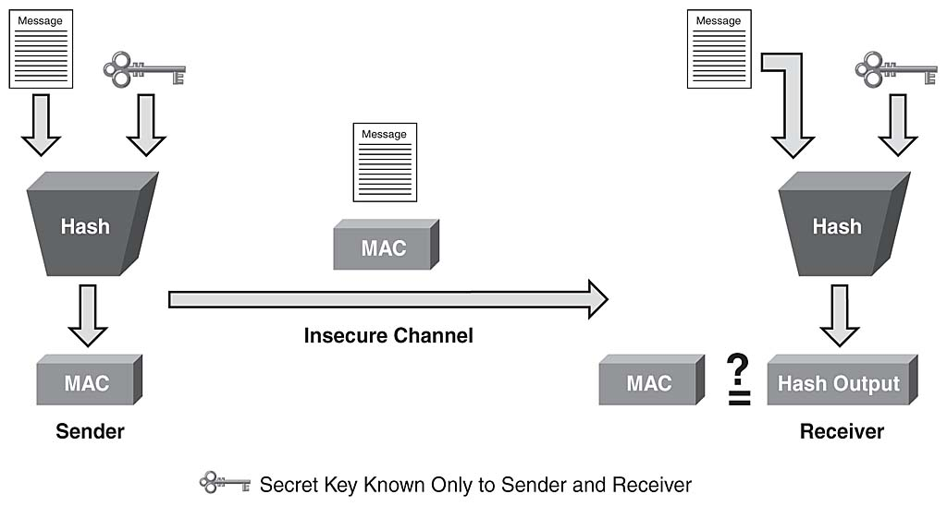
Message Authentication Code (MAC)

Slide 17
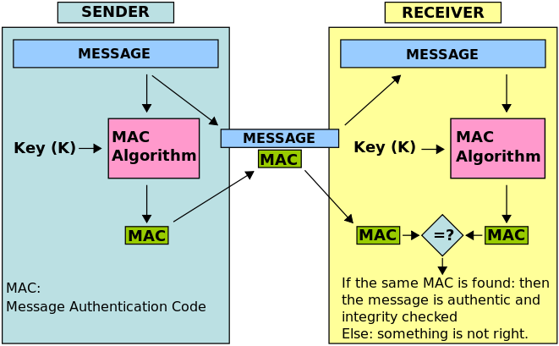
Principle of Message Authentication Code (MAC)
MACs append an authentication tag to a message
MACs use a symmetric key k for generation and verification
Notes:
Similar to digital signatures,
Message Authentication = Integrity + Source Authentication
Computation of a MAC = MAC_{k}(m)
Application: MAC
Hashing with a key. The goal is to create a hash that can only be created or verified by someone with the key
Different techniques
H(m | K)
Bad because of how some hash functions are designed
H(K | m)
Better
H(K | m | K)
Better still
H(K | H(K | M) )
Provable good. (But slower)
Message Authentication = Integrity + Source Authentication

Slide 18
Properties of MAC
Cryptographic hash A MAC generates a cryptographically secure authentication tag for a given message. MAC accept a message of arbitrary length and generate fixed-size authentication tag.
Symmetric MACs are based on secret symmetric keys. The signing and verifying parties must share a secret key.
Message integrity MACs providemessage integrity: Any manipulations of a message during transit will be detected by the receiver.
(An attacker who alters the message will be unable to alter the associated MAC value without knowledge of the secret key)
Message authentication The receiving party is assured of the origin of the message.
No nonrepudiation Since MACs are based on symmetric principles, they do not provide nonrepudiation.
Notes:
Brute-force attacks exploiting ➢Strong collision resistant hash have cost min(2k, 2n), k=size of key, n=size of the hash
➢MACs with known message-MAC pairs Can either attack keyspace (cf key search) or hash
128-bit hash looks vulnerable, 160-bits better

Slide 19
MACs from Hash Functions
MAC can be realized with cryptographic hash functions (e.g., SHA-1)
Basic idea: Key is hashed together with the message
Two possible constructions:
secret prefix H(K | m )
secret suffix H(m | K)
Both are vunerable to attacks
For better security combine secret prefix and suffix as done by HMAC (see next slide)
Notes:
Different techniques
H(m | K)
Bad because of how some hash functions are designed
H(K | m)
Better
H(K | m | K)
Better still
H(K | H(K | M) )
Provable good. (But slower)
secret prefix MAC: Attack MAC for the message x = (x1,x2, . . . ,xn,xn+1), where xn+1 is an arbitrary additional block, can be constructed from m without knowing the secret key
secret suffix MAC: find collision x and xO such that h(x) = h(xO), then m = h(x||k) = h(x_{O}||k)

Slide 20
HMAC
Proposed by Mihir Bellare, Ran Canetti and Hugo Krawczyk in 1996
HMAC (keyed-hash message authentication code) uses a cryptographic hash function and a secret key.
It may be used to simultaneously verify both the data integrity and the authentication of a message.
Any cryptographic hash function, such as SHA256 or SHA-3, can be used to compute the HMAC (e.g. HMAC-SHA256 or HMAC-SHA3)
Notes:
In cryptography, an HMAC (sometimes expanded as either keyed-hash message authentication code or hash-based message authentication code) is a specific type of message authentication code (MAC) involving a cryptographic hash function and a secret cryptographic key. It may be used to simultaneously verify both the data integrity and the authentication of a message, as with any MAC. Any cryptographic hash function, such as SHA256 or SHA-3, may be used in the calculation of an HMAC; the resulting MAC algorithm is termed HMAC-X, where X is the hash function used (e.g. HMAC-SHA256 or HMAC-SHA3). The cryptographic strength of the HMAC depends upon the cryptographic strength of the underlying hash function, the size of its hash output, and the size and quality of the key.
HMAC uses two passes of hash computation. The secret key is first used to derive two keys – inner and outer. The first pass of the algorithm produces an internal hash derived from the message and the inner key. The second pass produces the final HMAC code derived from the inner hash result and the outer key. Thus the algorithm provides better immunity against length extension attacks.

Slide 21
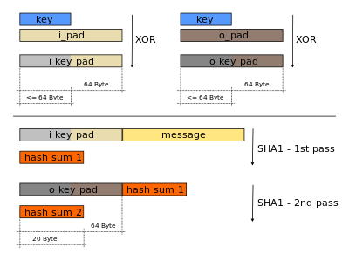
HMAC: HMAC-SHA1 generation example
opad - the outer padding: 0x5c5c5c…5c5c (one-block-long constant)
ipad - the inner padding: 0x363636…3636 (one-block-long constant)
Notes:
HMAC is provable secure which means (informally speaking): The MAC can only be broken if a collision for the hash function can be found.
Scheme consists of an inner and outer hash
k⁺ is expanded key k
expanded key k⁺ is XORed with the inner pad
ipad = 00110110,00110110, . . .,00110110
expanded key k+ is XORed with the outer pad
opad = 01011100,01011100, . . .,01011100
HMAC_{k}(x) = h[(k⁺⊕opad)||h[(k⁺⊕ipad)||x]]

Slide 22
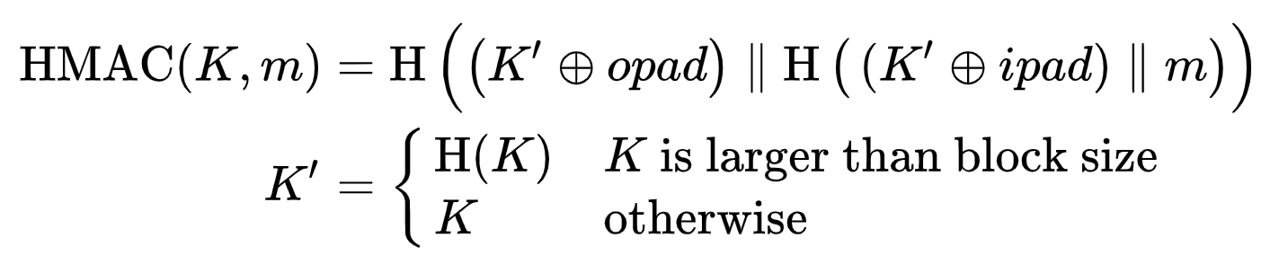
HMAC Algorithm
HMAC uses two passes of hash computation:
The secret key is first used to derive two keys:
opad is the outer padding, consisting of repeated bytes, valued 0x5c, up to the block size
ipad is the inner padding, consisting of repeated bytes, valued 0x36, up to the block size.
The first pass of the algorithm produces an internal hash derived from the message and the inner key.
The second pass produces the final HMAC code derived from the inner hash result and the outer key.
Notes:
H is a cryptographic hash function,m is the message to be authenticated,
K is the secret key,
K' is a block-sized key derived from the secret key, K; either by padding to the right with 0s, up to the block size, or by hashing down to the block size,
∥ denotes concatenation,
⊕ denotes bitwise exclusive or (XOR),
opad is the outer padding, consisting of repeated bytes, valued 0x5c, up to the block size, and
ipad is the inner padding, consisting of repeated bytes, valued 0x36, up to the block size.
The cryptographic strength of the HMAC depends upon the cryptographic strength of the underlying hash function, the size of its hash output, and the size and quality of the key.
Thus the algorithm provides better immunity against length extension attacks.

Slide 23
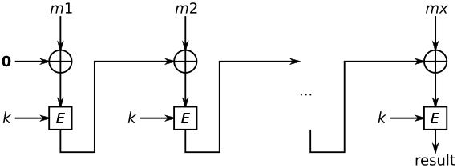
MAC from Block Ciphers: CBC-MAC
Cipher Block Chaining Message Authentication Code (CBC-MAC) constructs a MAC using a block cipher in CBC mode.
Create a chain of blocks such that each block depends on the encryption of the previous block.
This interdependence ensures that a change to any of the plaintext bits will cause the final encrypted block to change in a way that cannot be predicted.
The IV is initialized with zeros. MAC is the encrypted last block.
Notes:
Hash functions based on cipher block chaining
Popular: Use AES in CBC mode
In cryptography, a cipher block chaining message authentication code (CBC-MAC) is a technique for constructing a message authentication code from a block cipher. The message is encrypted with some block cipher algorithm in CBC mode to create a chain of blocks such that each block depends on the proper encryption of the previous block. This interdependence ensures that a change to any of the plaintext bits will cause the final encrypted block to change in a way that cannot be predicted or counteracted without knowing the key to the block cipher.
To calculate the CBC-MAC of message m one encrypts m in CBC mode with zero initialization vector. The following figure sketches the computation of the CBC-MAC of a message comprising blocks {\displaystyle m_{1}\|m_{2}\|\cdots \|m_{x}} using a secret key k and a block cipher E:

Slide 24
CBC-MAC
MAC Generation
Divide the message m into blocks m_{i}
Compute first iteration c₁ = e_{k}(m₁⊕IV). IV is initialized with zeros
Compute c_{i} = e_{k}(m_{i}⊕c_{i−1}) for the next blocks
Final block is the MAC value: m =MAC_{k}(m) = c_{n}
MAC Verification
Repeat MAC computation (m‘)
Compare results:In case m’ = m, the message is verified as correct
In case m’ ≠ m, the message and/or the MAC value m have been altered during transmission

Slide 25
MAC Summary
MACs provide two security services, message integrity and message authentication, using symmetric techniques. MACs are widely used in protocols.
Both of these services also provided by digital signatures, but MACs are much faster as they are based on symmetric algorithms.
MACs do not provide nonrepudiation.
In practice, MACs are either based on block ciphers or on hash functions.
HMAC is a popular and very secure MAC, used in many practical protocols such as TLS.

Slide 26
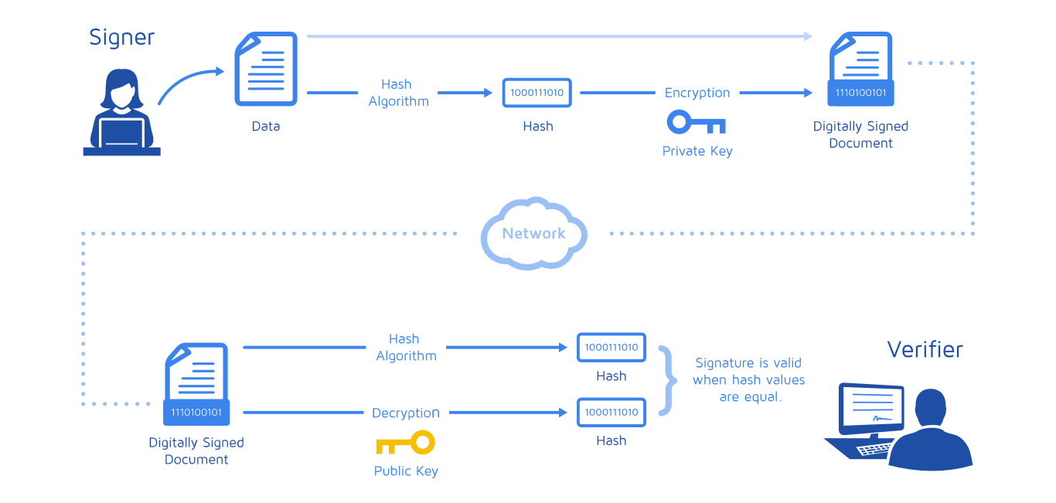

Digital Signature

Slide 27
Motivation
Alice orders a pink car from the car saler Bob
After seeing the pink car, Alice states that she has never ordered it
How can Bob prove towards a judge that Alice has ordered a pink car? (And that he did not fabricate the order himself)
Symmetric cryptography fails because both Alice and Bob can be malicious
Can be achieved with public-key cryptography

Slide 28
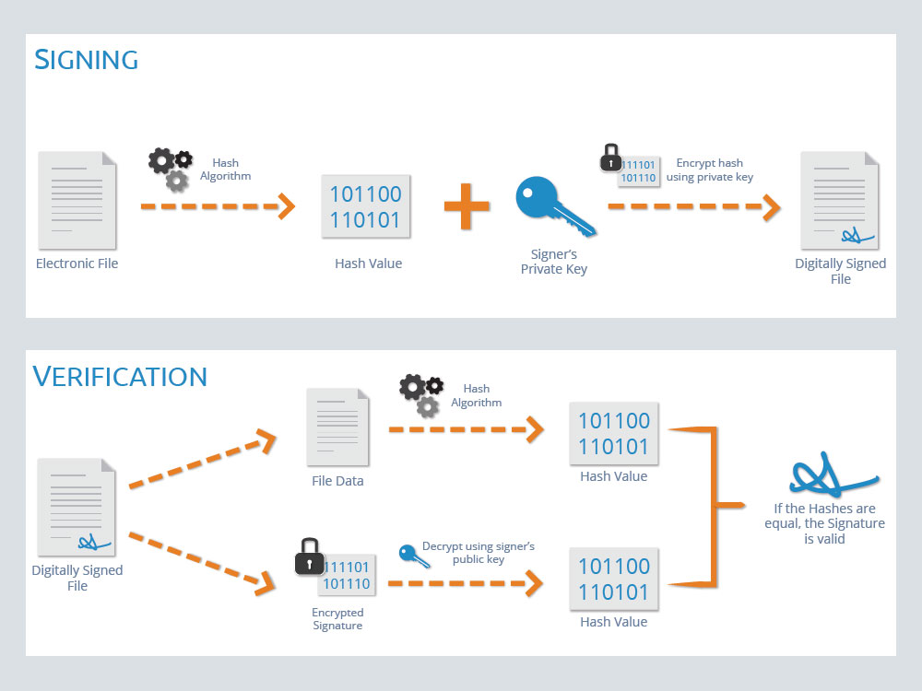
Basic Principle of Digital Signatures

Slide 29
Main idea
For a given message m, a digital signature is appended to the message (just like a conventional signature).
Only the person with the private key should be able to generate the signature.
The signature is realized as a function with the message m and the private key as input
The public key and the message m are the inputs to the verification function
An attacker who wishes to alter the message would need to know the user’s private key
Notes:
The signature must change for every document

Slide 30
DC Core Security Services
Integrity: Ensures that a message has not been modified in transit.
Message Authentication: Ensures that the sender of a message is authentic. An alternative term is data origin authentication.
Non-repudiation: Ensures that the sender of a message can not deny the creation of the message. (e.g. order of a pink car)
Notes:
The objectives of a security systems are called security services.
Confidentiality: Information is kept secret from all but authorized parties.
Identification/entity authentication: Establishing and verification of the identity of an entity, e.g. a person, a computer, or a credit card.
Access control: Restricting access to the resources to privileged entities.
Availability: The electronic system is reliably available.
Auditing: Provides evidences about security relevant activities, e.g., by keeping logs about certain events.
Physical security: Providing protection against physical tampering and/or responses to physical tampering attempts
Anonymity: Providing protection against discovery and misuse of identity

Slide 31
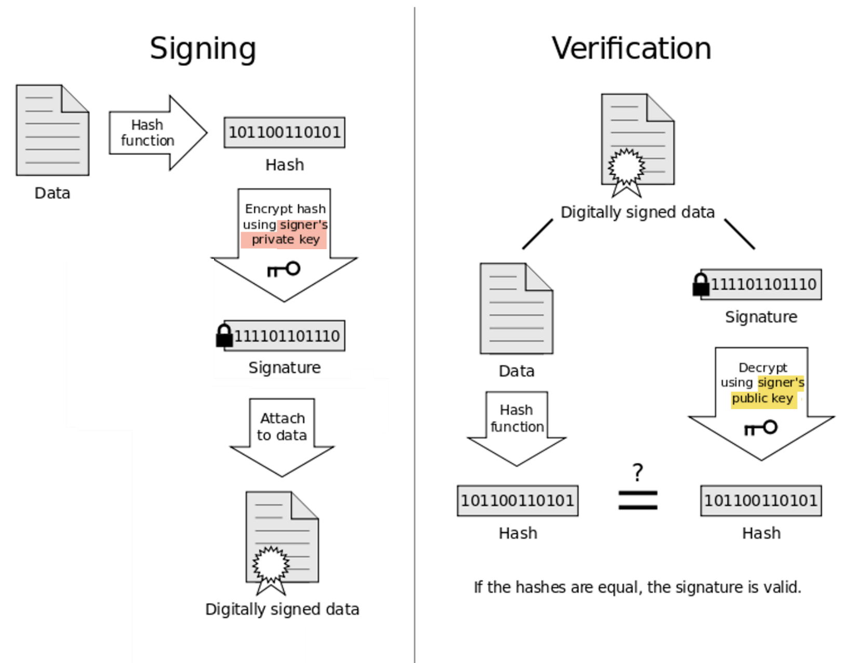
RSA signature process
Bob can verify that Alice sent the message (i.e., non-repudiation) and that the message has not been modified (i.e., integrity)
Notes:
To generate the private and public key:
Use the same key generation as RSA encryption.

Slide 32
Summary
Hash functions are used to compute a digest of a message. Must take variable size input, produce fixed size pseudorandom output, be efficient to compute
Cryptographic hash functions should be one-way and collision resistant
Cryptographic hashes are used for message authentication, digital signatures, password storage, detecting errors in file transfers, … etc.
Notes:
Hash functions take an arbitrary message, compute a fixed length hash
Hash functions are keyless. The two most important applications of hash functions are their use in digital signatures and in message authentication codes such as HMAC.
The three security requirements for hash functions are one-wayness, second preimage resistance and collision resistance.
Hash functions should have at least 160-bit output length in order to withstand collision attacks; 256 bit or more is desirable for long-term security.
MD5, which was widely used, is insecure. Serious security weaknesses have been found in SHA-1, and the hash function should be phased out. The SHA-2 algorithms all appear to be secure.
The ongoing SHA-3 in the new standardized hash function

Slide 33
Resources
Cryptographic hash function
https://simple.wikipedia.org/wiki/Cryptographic_hash_function
HMAC
https://en.wikipedia.org/wiki/HMAC
Digital signature
https://en.wikipedia.org/wiki/Digital_signature

